Slide 1
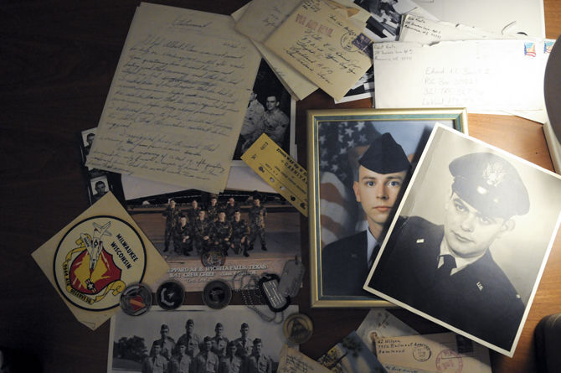

Slide 2
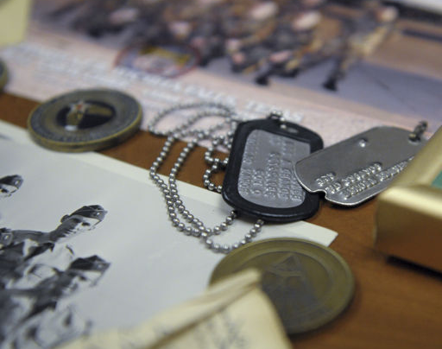
Project Summary
In its entirety, the Virtual Footlocker Project focuses on the development of an open-source, cross-system platform system for capturing and preserving the personal communication and documentary record of the modern soldier.

Slide 3
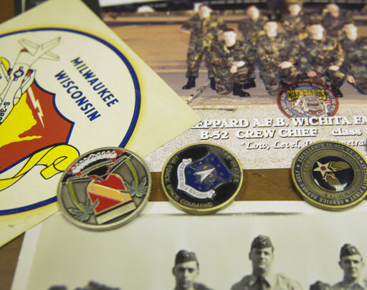
Multi-Phase Project
Phase 1: Survey of recent veterans & active duty military (completed)
Phase 2: Development of technical requirements & functional framework (in progress)
Phase 3: Protocol development & testing
Phase 4: Launch & distribution

Slide 4
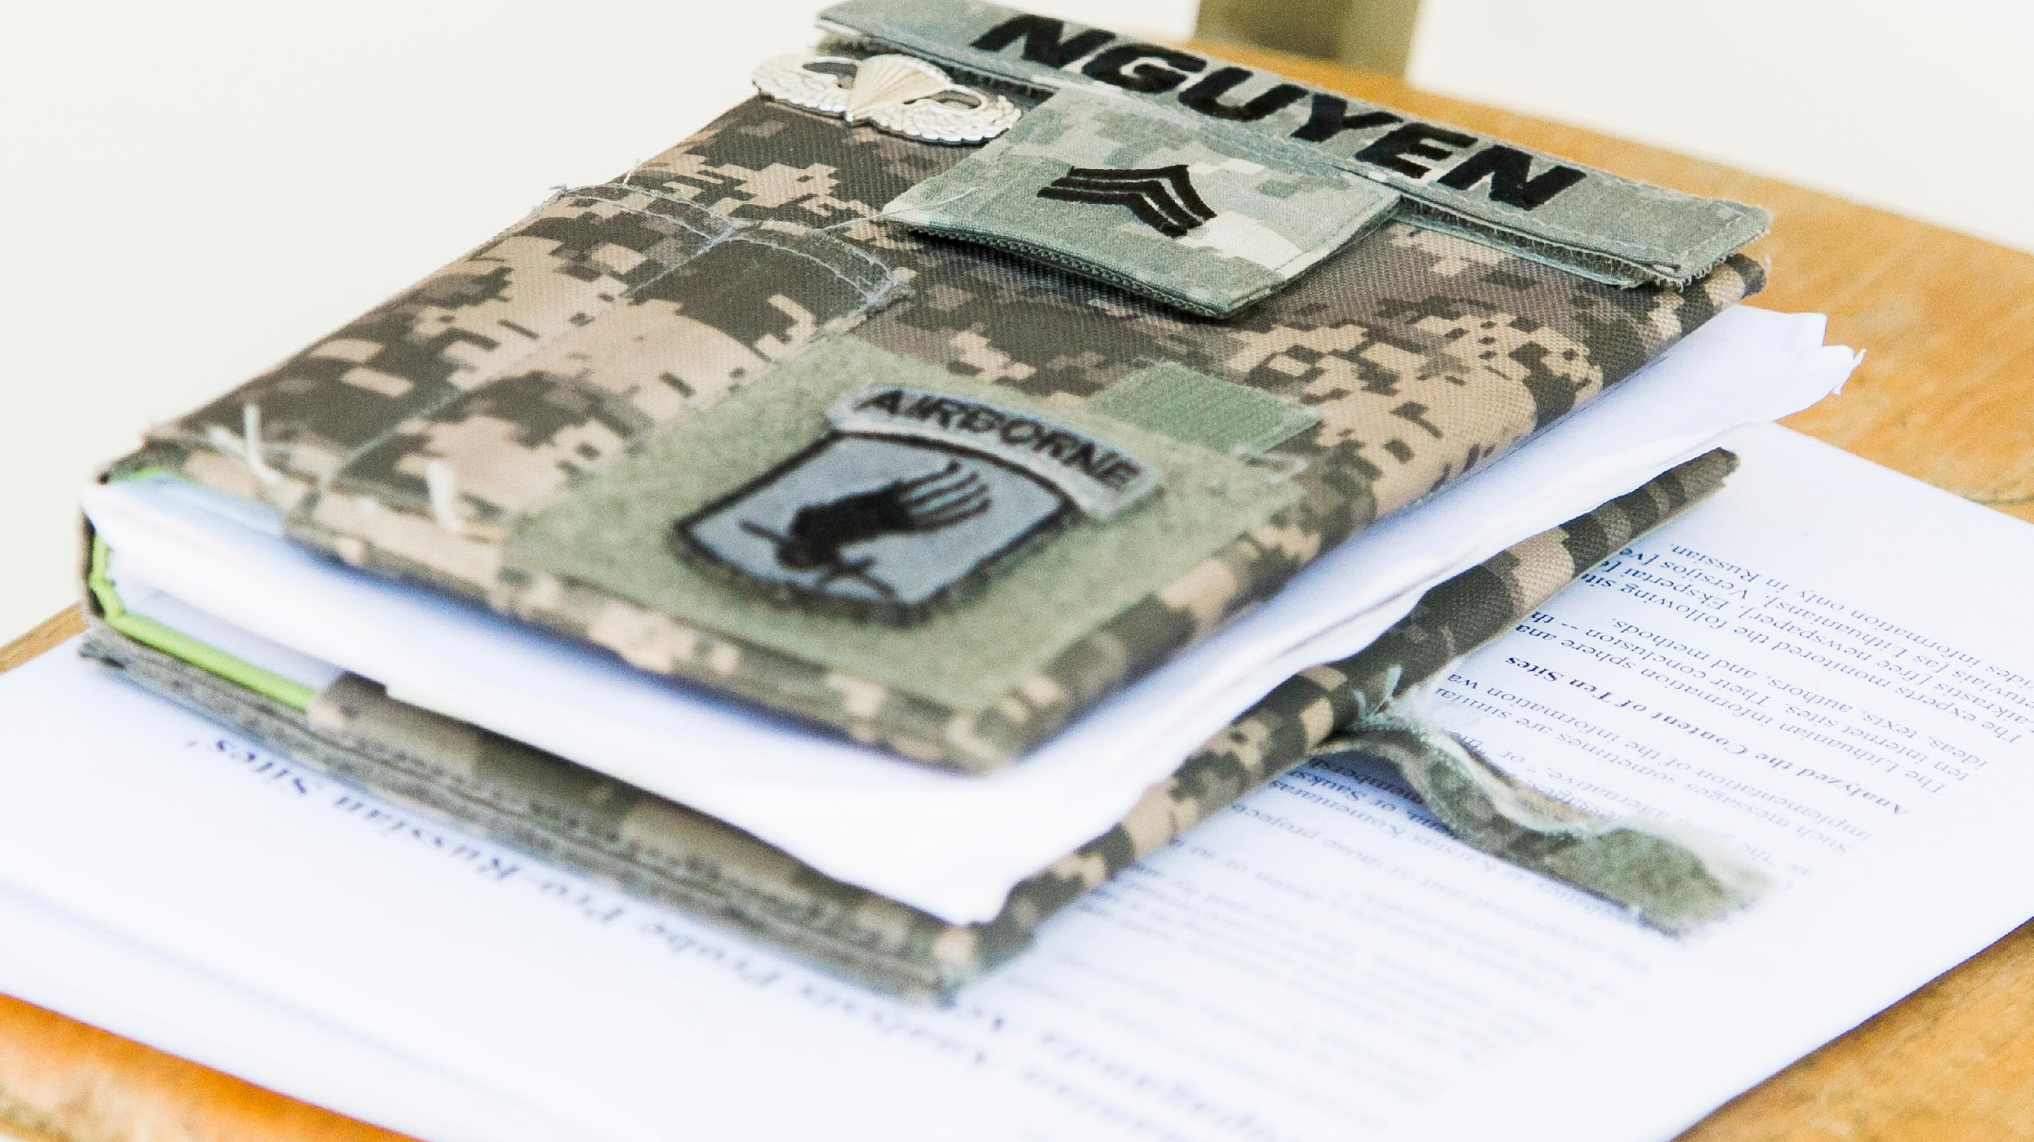
Elements of Phase Two
Institute of Museum & Library Services (IMLS) Grant: $390,706
Advisory Board
Focus Groups
Analysis and Technical Mapping
Workshop Development

Slide 5
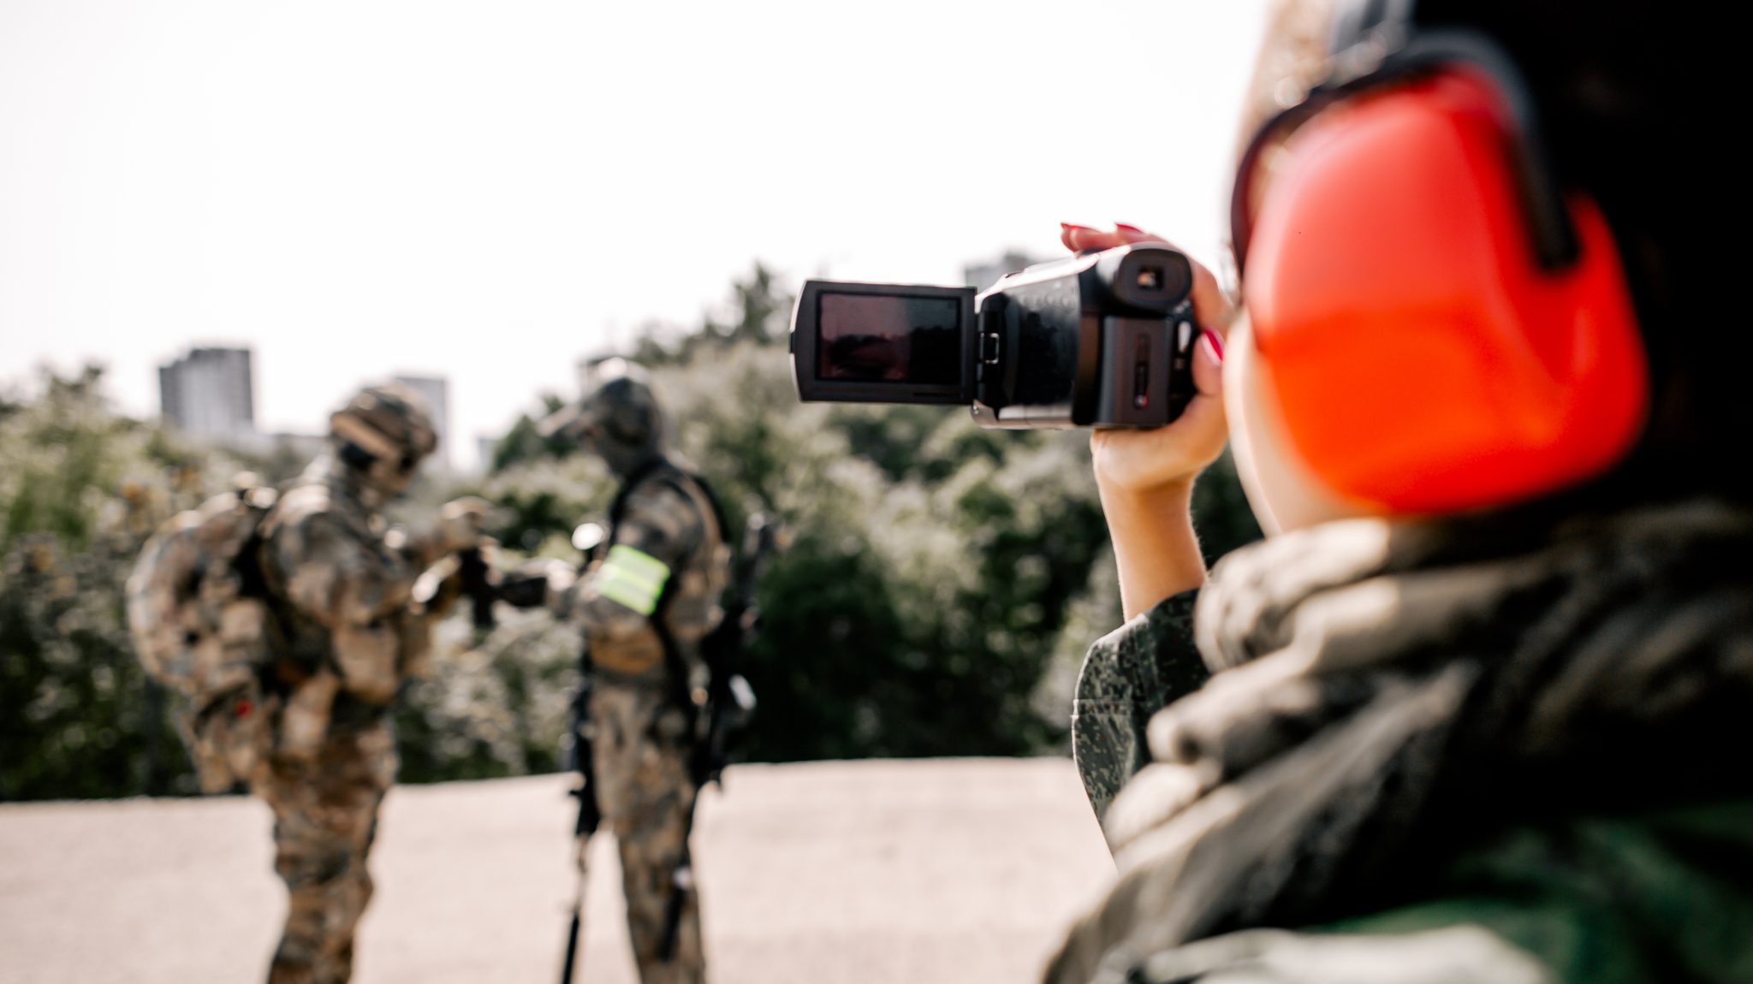
Focus Groups
Two focus groups for each military branch (one for officers, one for enlisted)
Six locations:
Baton Rouge, LA (Pilot)
Shreveport, LA (Women only)
Ft. Benning, GA (Army)
Anchorage, AK (Coast Guard)
San Diego, CA (Navy & Marines)
Dayton, OH (Air Force)
1.5-hour sessions & $150 compensation

Slide 6
The world turned upside down…
Coronavirus pandemic shutdown all in person focus group plans
Reconfiguring study for online participation

Slide 7
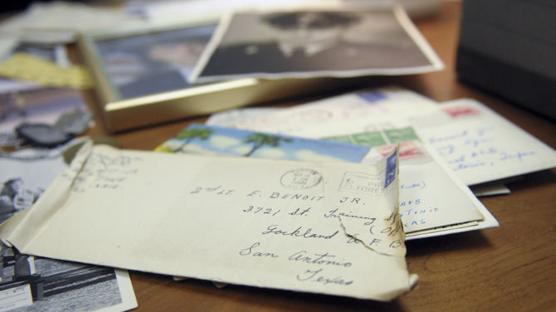
Changes to Protocol
All focus groups shifted to Zoom-based
Increased number of focus groups from 12 to 23 (and a pilot study)
Expanded recruitment geographically
Spread focus groups across entire summer
Used Adobe Sign for informed consent documents
Postdoctoral researcher to work remotely for 2020-2021

Slide 8
Zoom Lessons
Waiting Room
Changing Screen Names
Recording to the Cloud (w/Transcription)
Capture Chat Box
Phone or Video Connections
Speaking Delay

Slide 9
Moving Forward

Slide 10
Follow us!
www.virtualfootlocker.com
www.facebook.com/virtualfootlocker
@vrt_footlocker
@virtualfootlocker

Slide 11
Questions?

